Slide 1
Astronomy
Big Bang Theory

Slide 2
Astronomy Foundations the big bang theory
The SCIENTIFIC explanation of the universe, how it exists, how we study it, and how it began is based upon what is known as the BIG BANG THEORY.
Recall, a THEORY is an well-tested explanation for a concept based on a collection of related hypotheses.
Theories are the best scientific explanation based upon available data.
However…
Theories can be believed or not.
They can never really be verified completely due to limitations in our current science.
Sometimes, theories can be falsified, updated, or replaced.

Slide 3
According to the big bang theory… In the beginning…
The entire universe, all matter and energy was contained in a single point…

Slide 4
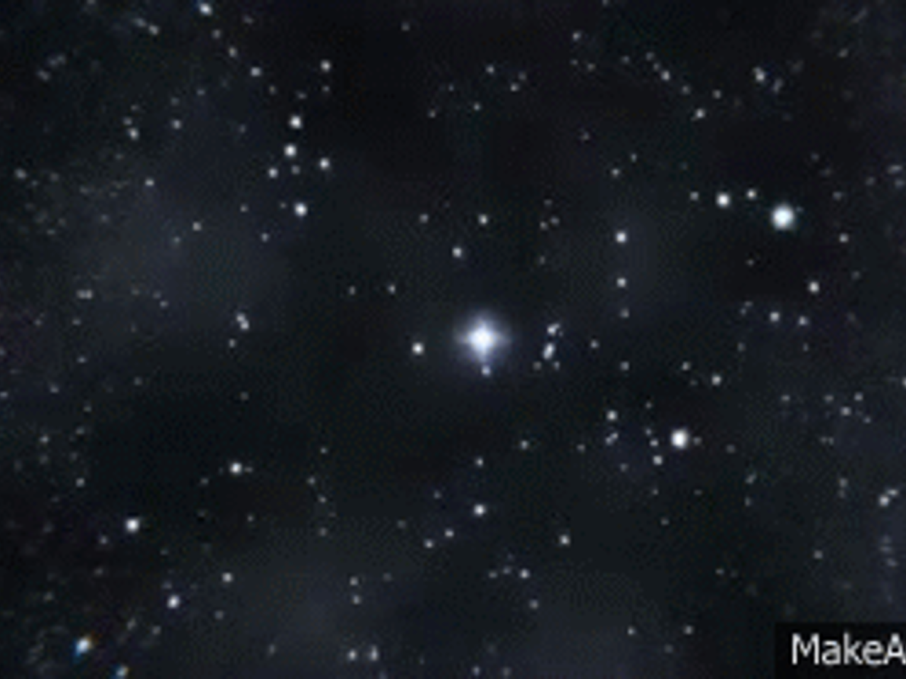
From this point…
All the energy in this point was released by some unknown mechanism shooting out all this energy in every direction at the same time.
After this initial event, physical laws influenced the energy released, allowing the universe to evolve into what we know about it today.

Slide 5
Astronomy Measurements
We measure distances in space largely on two units:
Astronomical unit (AU): the average distance between the Earth & Sun.
It’s approximately 93 million miles.
This is used primarily for our solar system.
Light Years: the distance it takes light to travel through space in one year.
Light travels at a known speed: 299,792km/sec.
We use this unit to measure distances to and between other stars and galaxies outside our own solar system.
Can be broken down into:
Light Minutes:
Light Seconds: Roughly 300,000 miles

Slide 6
Illustration: AU

Slide 7
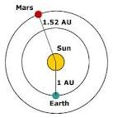
1 AU = 150,000,000KM

Slide 8
Illustration: Light Year
Roughly equals 1AU

Slide 9
Sizes in Space
Things in space range from the subatomic to ridiculously large.
You’re probably aware of some relative sizes already.
In order for you to truly understand the universe you must be able to relate relative sizes.
Can you place these in their relative sizes, from smallest to largest?
Comet
Galaxy
Universe
Planet
Star
Asteroid
Moon
Solar system
Asteroid… remnants of planets that escaped gravity.
Comet… icy balls of matter that orbit stars
Moons… orbit planets
Planets… orbit starts
Stars… are the center of solar systems, but orbit within galaxies.
Solar system… stars with planets orbiting
Galaxy… cluster of stars in a defined region
Universe… all reaches of known existence
Smallest
Largest

Slide 10
General Relative Sizes within our solar system

Slide 11
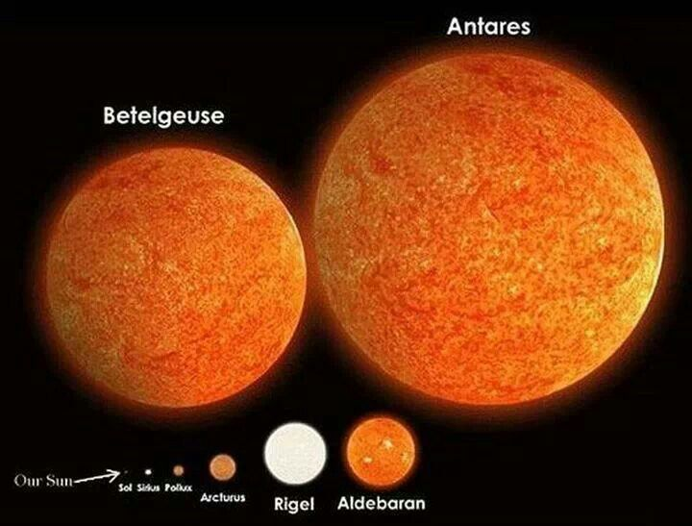
Relative Sizes: Various Stars
Our sun is pretty large in comparison to us, but our star is tiny compared to other stars that exist in the observable universe.

Slide 12
Back to the Universe…
Once the big bang happened…
Energy expanded from a single point in space in all directions.
As it expanded, the energy slowed, cooled, and subatomic particles formed…
These particles aggregated (collected together) and formed hydrogen, the first element.
This element had mass, which had gravity.
The gravitational pull from these atoms collected other atoms, forming cloud-like structures.
This growing mass bore the first starts.
These stars grew and along with it so did their gravity.
As gravity increased the atoms in the start eventually collapsed onto themselves, causing nuclear reactions (nuclear fusion).
This fusion created larger elements, like helium and lithium.
This process continues, over and over, until all the elements were created.
All the while, these stars continues to expand away from each other, eventually forming galaxies, solar systems, planets, moons, and all the other celestial bodies known to exist.

Slide 13
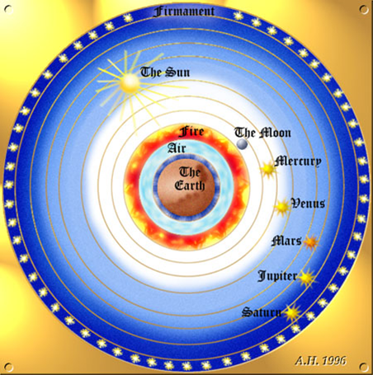
How do we Know???
Significant discoveries have marked an evolution of our understanding of the universe.
At first, humans believed we were the center of the universe, with everything revolving around us.
This view, the GEOCENTRIC MODEL based upon Ptolemy (Athenian scholar), was believed all the way up until…

Slide 14
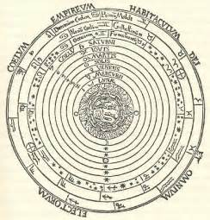
How We Know: The Earth isn’t the center…
In the 15th and 16th centuries, two brilliant and brave individuals confronted the inconsistencies in the Geocentric Model, instead arguing the Sun is the center of the universe, called the HELIOCENTRIC Model.
First: Copernicus (1550’s), (on his deathbed) proposed mathematical models that suggested the Earth revolved around the sun
Next (and most importantly) Galileo (early 1600s): Proved with the use of his telescope that the Earth revolved around the Sun, plus discovered that Jupiter had moons that revolved around it and Venus had phases.
Then Kepler fine-tuned the theory of a HELIOCENTRIC (sun-centered) universe with planets following elliptical revolutions.

Slide 15
How We Know: Fine-Tuning Our Understanding
Herschel (late 1700’s): Mapped the Milky way galaxy
= space is a lot bigger than we thought…
Einstein (1915): Relativity. Large masses (like the sun) can bent light and cause distortions in space.
= we can factor this in to better understand the relative sizes of celestial bodies…
= also gave us E= mc²: Energy can be converted into matter and vice versa.
Hubble (1920’s): Discovered other galaxies and THEY WERE MOVING AWAY FROM EACH OTHER!!!
= scientific heads are starting to hurt now…SOURCE?
Jansky (1930): Discovered radio waves are flying through space, originating from a single source
….BIG BANG

Slide 16
More on Hubble: Hubble’s Law
In 1929, Hubble was the first to provide proof that the universe is not static, that it’s moving and moving from a central point with everything slowly drifting away from the center at increasing speeds.
Georges Lemaitre (1927) actually proposed this first, Hubble confirmed.
In his research, Hubble discovered a correlation (a relationship) between the distance of other galaxies and the speed at which they are moving away from us.
The farther away the galaxy is, the faster it is moving away from Earth.
He used the red-shift (moving away)/blue-shift (moving towards) Doppler Effect to determine the direction of travel for the distant galaxies observed.
Note: not all galaxies are moving away from us. Andromeda, our closest galactic neighbor, is moving toward us.

Slide 17
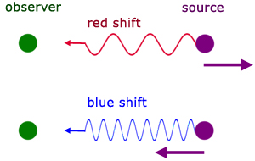
Hubble Used the Doppler Effect to determine that certain celestial bodies were moving, but also in what general direction…

Slide 18
Illustration of Hubble’s Law

Slide 19
So things in the galaxy are moving…
But are they moving randomly?
No!
All evidence from Hubble (and others) points to the conclusion that everything is moving from a central location…

Slide 20
THE BIG BANG
Using types of linear regression (like watching a movie going backward), we can retrace the path of matter and energy moving in the universe back to a single point.
What the Big Bang Theory states is that the universe was created from the release of all the energy in existence from a single point, 14.7 billion years ago.
From there, the laws of physics acted on the energy eventually leading to the creation of all the elements and matter that we observe today (ala Einstein).

Slide 21
Big Bang Theory Overview

Slide 22
Events of the Big bang Theory
Wirtz (1910): Red shifts detected.
Einstien (1916): Energy and matter are interchangeable
Hubble (1929): Confirms galaxies are moving
Jansky (1932): Discovers cosmic radio waves
Penzias & Wilson (1965): Detect cosmic background radiation. It’s dispersal points to a central origin.

Slide 23
Conclusion
The Big Bang Theory, much like the theory of evolution, will likely never be proven because of limitations in science (like time travel, for example), but it is the best scientific explanation for the universe and its creation.
Do you have to believe it?
No.
You may believe what you want, but you must know what the Big Bang is, especially if you want to pass this part of the course ☺

Slide 24
Questions????
If you have any comments to make or questions to ask, now is the time.

